Slide 1

ERHS KEY CLUB
September 17, 2013

Slide 2
PLEDGE
I pledge on my honor to uphold the objects of Key Club International; to build my home, school, and community; to serve my nation and God; and combat all forces which tend to undermine these institutions.

Slide 3
Memebership
Cost: $14
What does it your membership include?
Official recognition as a member of Key Club International
You will receive a pin and a certificate
The remaining $3 from your membership helps pay for your fall rally ticket

Slide 4
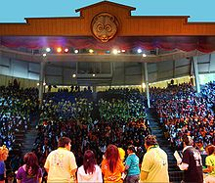
Fall Rally
  When: Nov. 9, 2013
  Where: Six Flags Magic Mountain !
  Cost: $48

Slide 5
Service Events ~

Slide 6
Volunteering Opportunities
PET SMARTS
  When: Saturdays
  Shifts: 10:30am-12:30pm, 12:30pm-2:30pm, 2:30pm-5pm
  Where: PetSmart next to Staples in Eastvale
Eastvale Clean Up (Sept. 28)
    When: 8am-11am
    Where: J.C. Huber Park
Car Wash at 7-11 (Sept.28)
  When: 9am-3pm
  Where: Archibald Ave & Schleisman Ave

Slide 7
Volunteering Opportunities
Fall Festival
  When: Oct. 5
  Shifts: 1:30pm-3:30pm, 3:30pm-5:30pm, 5:30pm-7:30pm, 7:30-9pm
  Harada Park
Eastvale 5K/Healthy Eastvale Fair
    When: 6am-12am
    Where: Here at ERHS !

Slide 8

Division Spirit Pack
Pre-sale : $8
Regular: $10
items include:
- 1 black lei
- 1 black&teal pompom
- 1 teal bandana
- 1 black mini-megaphone necklace
- 2 fruitsnacks

Slide 9

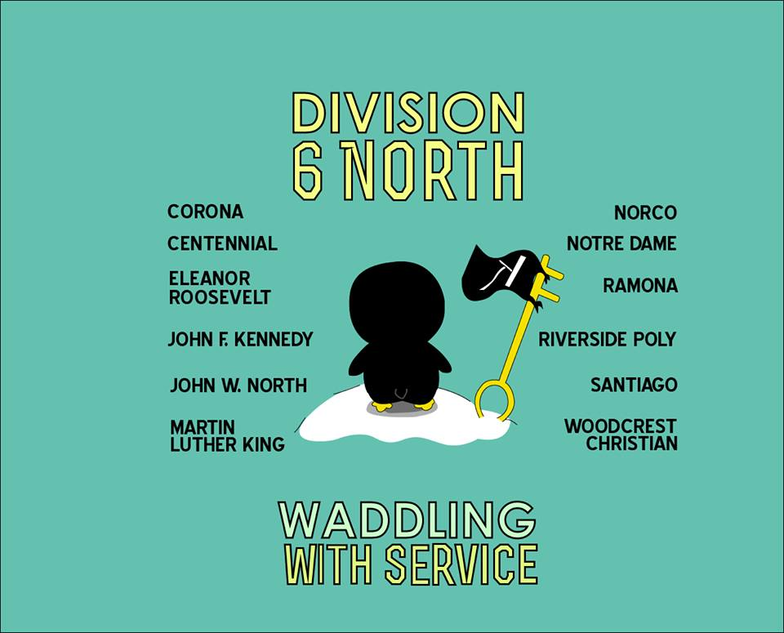
Division T-Shirts
Pre-sale : $8
Regular: $10
Front
Back

Slide 10
Division Sweatshirt
Pre-sale : $15
Regular: $20

Slide 11
MEETING ADJOURNED !
DON’T FORGET:
  Join Key Club !
  Sign up for Service events !
  Purchase T-Shirts & Sweatshirts !
  HAVE A NICE DAY ! ☻☺

